Slide 1
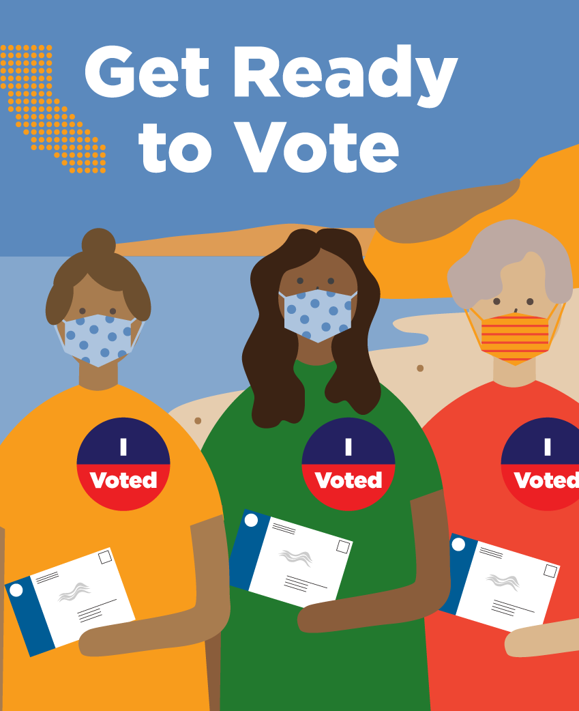
Voting Matters
So, let’s talk about it!
6pm, Thursday, Oct. 1, 2020
Santa Cruz County Clerk Gail L. Pellerin

Slide 2
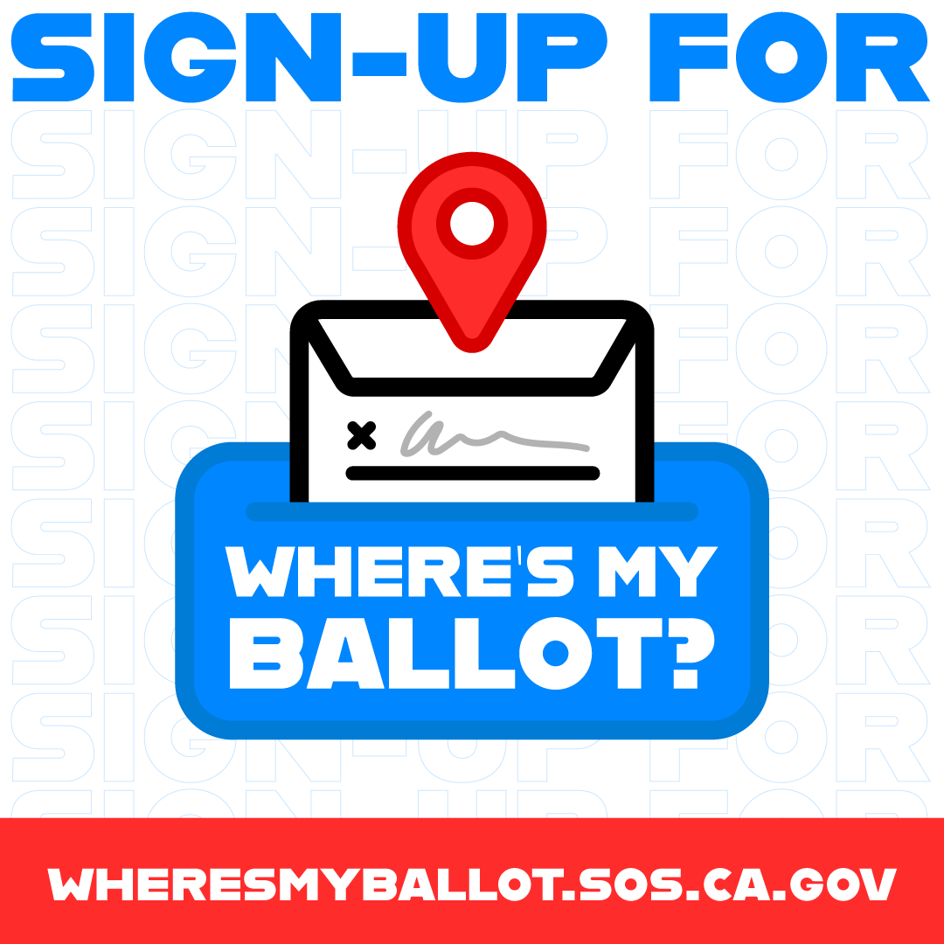
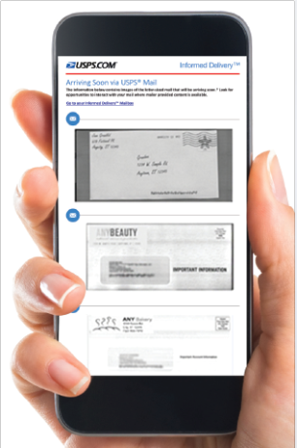
Track it!
Sign up to track your ballot at wheresmyballot.sos.ca.gov
You will get an alert when:
  Your ballot enters the mail stream.
  Your ballot is in your mailbox.
  Your ballot our is received and accepted by the county elections office.
Other alerts may include: when your voted ballot enters the mail
stream (if you are mailing it back), if there is a problem with your
signature, if we can’t count your ballot for any reason, if your
ballot is undeliverable.
To track ALL of your mail, sign up for informed delivery at usps.com

Slide 3

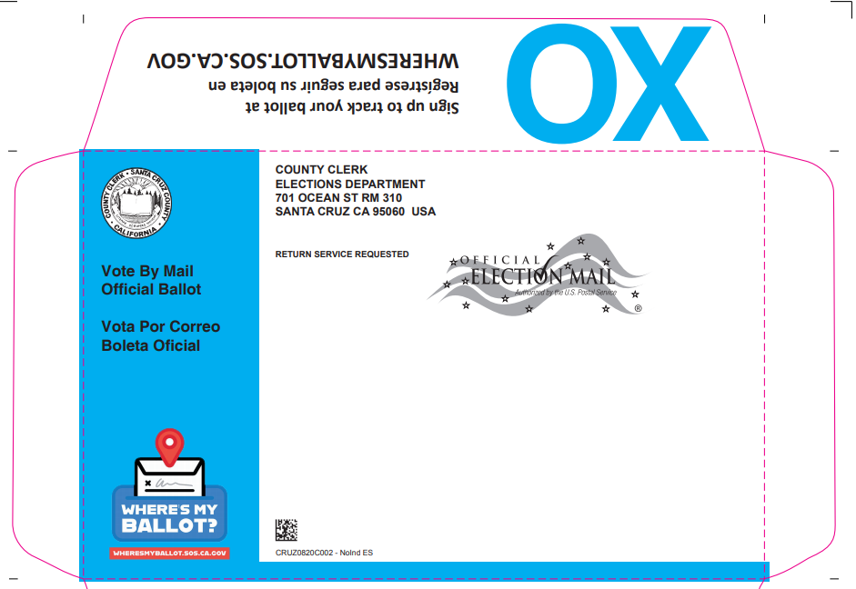
Ballots will be mailed Fri. Oct. 2!
Our ballots will be mailed with a hug and a kiss!

Slide 4
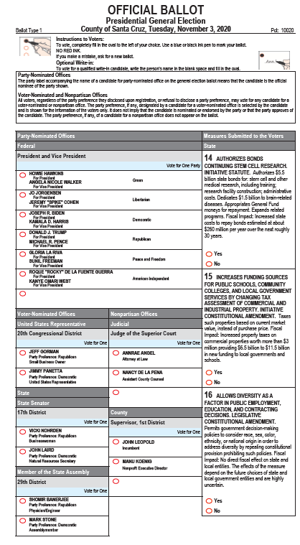
Traditional Paper Ballot
Fill in the oval to the left of your choice.
For most contests, your choice is ONE but for others, like some city council or school and special districts, you may be able to vote for two, three or four candidates.
You may vote for fewer candidates than allowed, but if you vote for more candidates than allowed, your vote(s) in that contest will NOT be counted.

Slide 5
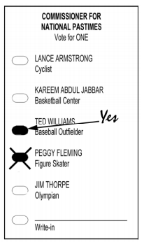
Voting Tips
Voting is NOT a test.
You do not have to vote on every single contest.
If you make a mistake, you can either get a replacement ballot or clearly correct it on the ballot.
To correct your ballot, make a distinct “X” through the mismarked oval, mark your preferred choice, and print or write legibly “Yes” next to the name of your candidate or measure choice. Do not put your initials, name or other identifying marks on the ballot.

Slide 6
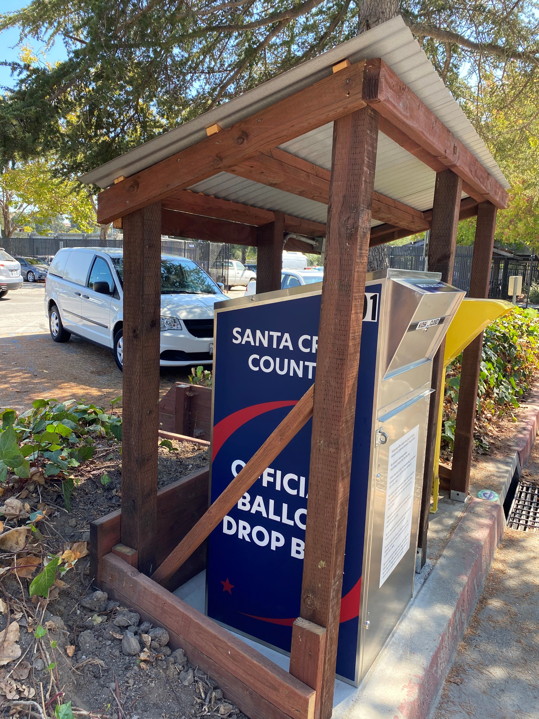
Just because we mail you a ballot, you don’t have to mail it back!
We will have 15 ballot drop boxes available 24/7 from October 6 until 8pm on Tuesday, November 3.

Slide 7
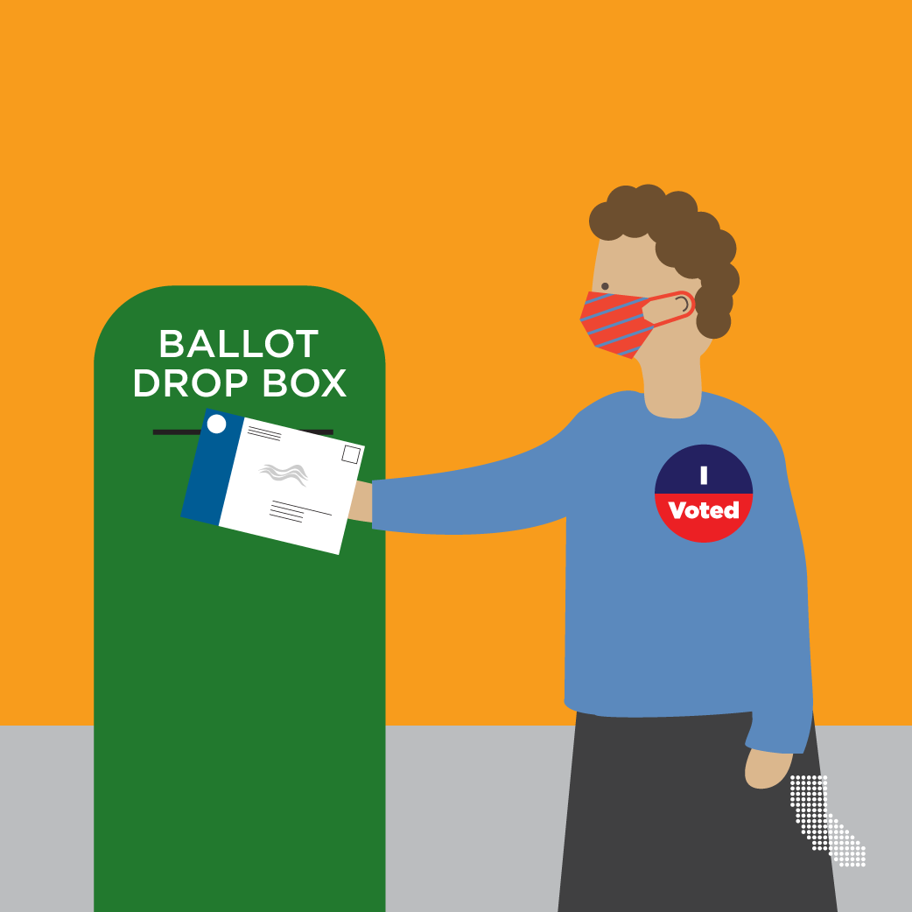
Ballot drop box locations
Aptos - Public Library, 7695 Soquel Dr.
Aptos - Polo Grounds, 2255 Huntington Dr.
Aptos - Cabrillo College by football stadium, 3732 Cabrillo College Dr.
Ben Lomond - Highlands Park, 8500 Highway 9
Boulder Creek - Library, 13390 W. Park Ave.: walk up
Capitola - City Hall, 420 Capitola Ave.
Capitola - Shopping Mall (near Sears), 1855 41st Ave.
Felton - Covered Bridge Park, Mt. Hermon/Graham Hill Rd.
Santa Cruz - County Gov. Center, 701 Ocean St.
Santa Cruz - Public Library, 212 Church St.
Santa Cruz - UCSC Quarry Plaza: walk up
Scotts Valley - City Hall, 1 Civic Center Dr.
Watsonville - Parking Lot 14, 316 Rodriguez St.
Watsonville - County Health Center, 1430 Freedom Blvd.
Watsonville - Corralitos Community Center, 35 Browns Valley Rd.

Slide 8
Inside ballot drop box locations
County Elections: 701 Ocean St., Room 310, Santa Cruz
Santa Cruz City Clerk: 809 Center St., Santa Cruz
Simpkins Swim Center: 979 17th Ave., Santa Cruz
Capitola City Clerk: 420 Capitola Ave., Capitola
Scotts Valley City Clerk: 1 Civic Center Dr., Scotts Valley
Watsonville City Clerk: 275 Main St., 4th Floor, Watsonville
Watsonville Public Library: 275 Main St., 1st Floor, Watsonville
We will also have a drop box at each residential care facility for their residents.

Slide 9
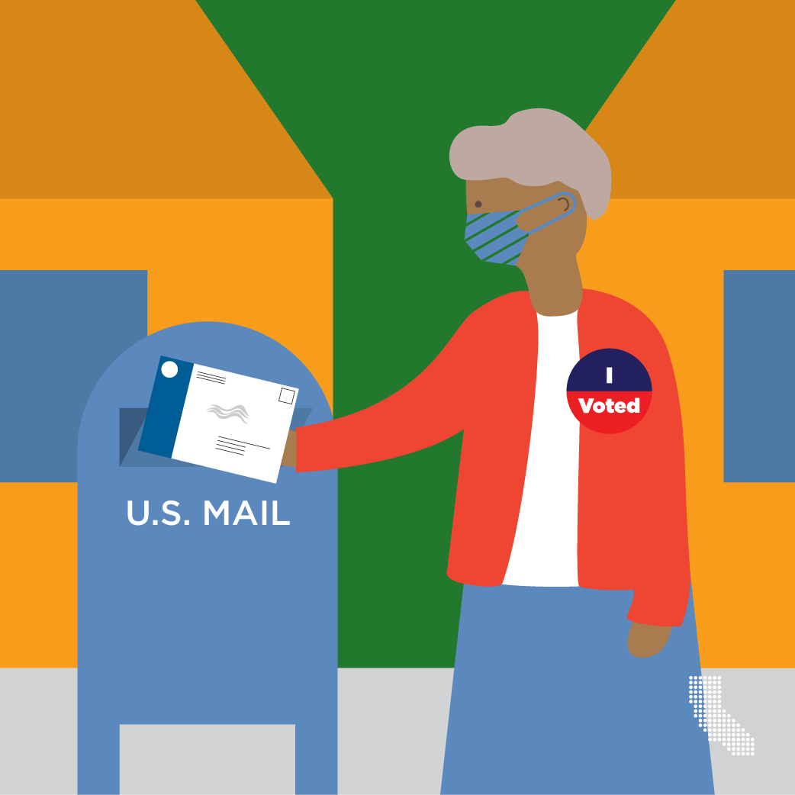
If you mail your ballot, make sure it is postmarked on or before November 3!
Ballots postmarked on or before November 3 and received by the elections official by November 20 will be considered received on time and will be counted if the voter is eligible to vote.
If you mail it on November 3, walk it into the post office and have it postmarked!
Postage is paid!

Slide 10
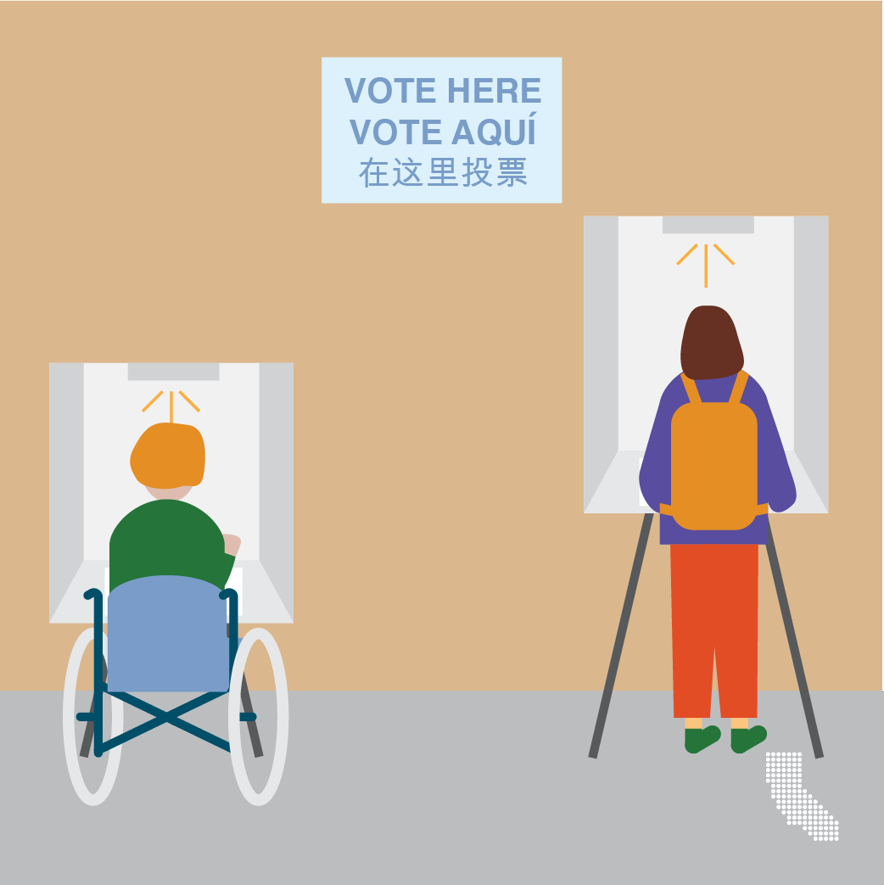
In-Person voting locations
Open:
Saturday, October 31, 2020, 9am to 5pm
Sunday, November 1, 2020, 9am to 5pm
Monday, November 2, 2020, 8am to 5pm
Tuesday, November 3, 2020, 7am to 8pm
Aptos - Temple Beth El, 3055 Porter Gulch Rd.
Boulder Creek - Boulder Creek Recreation Hall, 13333 Middleton Ave.
Capitola - New Brighton Middle School, 250 Washburn Ave.
Felton - San Lorenzo Valley High School, 7105 Highway 9
Santa Cruz - Santa Cruz County Clerk/Elections, 701 Ocean St., Room 310 – Opens Oct. 5 for voting
Santa Cruz - Simpkins Swim Center, 979 17th Ave.
Santa Cruz - Bonny Doon Elementary School, 1492 Pine Flat Rd.
Santa Cruz - Kaiser Permanente Arena, 140 Front St.
Santa Cruz – Masonic Center, 828 N. Branciforte Ave.
Santa Cruz - Natural Bridges School, 255 Swift St.
Scotts Valley - Scott Valley Community Center, 360 Kings Village Rd.
Scotts Valley - SV High School, 555 Glenwood Dr.
Soquel - Soquel High School, 401 Soquel-San Jose Rd.
Watsonville - Watsonville City Clerk’s Office, 275 Main St., 4th Floor – Opens Oct. 5 for voting
Watsonville - Pajaro Valley Community Trust, 85 Nielson St.
Watsonville - La Selva Beach Clubhouse, 314 Estrella Ave.
Watsonville - Santa Cruz County Fairgrounds, 2601 East Lake Ave.
Watsonville - Calabasas Elementary School, 202 Calabasas Rd.
Santa Cruz - UCSC, Merrill Cultural Center - open ONLY Monday, Nov. 2, 8am to 5pm and
Tuesday, Nov. 3, 7am to 8pm
Locations are subject to change. Check www.votescount.us for latest information.

Slide 11
Voting location safety checklist
Wear a face covering while at the voting location.
Keep 2 arms’ length distance from other people.
Wash hands before and after entering the voting location.
Use hand sanitizer after touching doors or voting equipment.
Bring your own pen.
We will take your temperature upon entering.
Want more information about how to stay safe while voting?
Review Centers for Disease Control and Prevention guidelines at www.cdc.gov/coronavirus/2019-ncov/community/election-polling-locations.html

Slide 12
We need to flatten the voting curve!

Slide 13
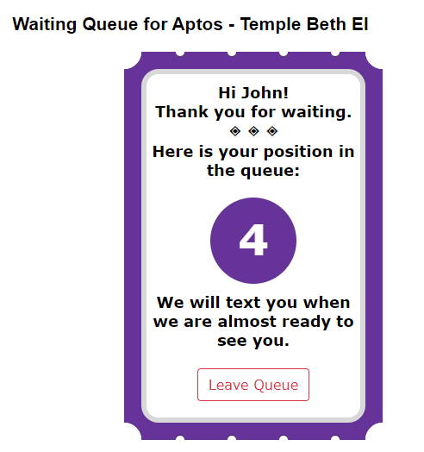
Line Management
Wait Time App
Voters will be let in if there is sufficient space.
If not, you will be put into the queue with your cell phone number, email or you can wait in a designated area.
When it is your turn, you will get an alert to come in and vote.
You can check wait times at the different voting locations online at www.votescount.us or on the My Santa Cruz County App.

Slide 14
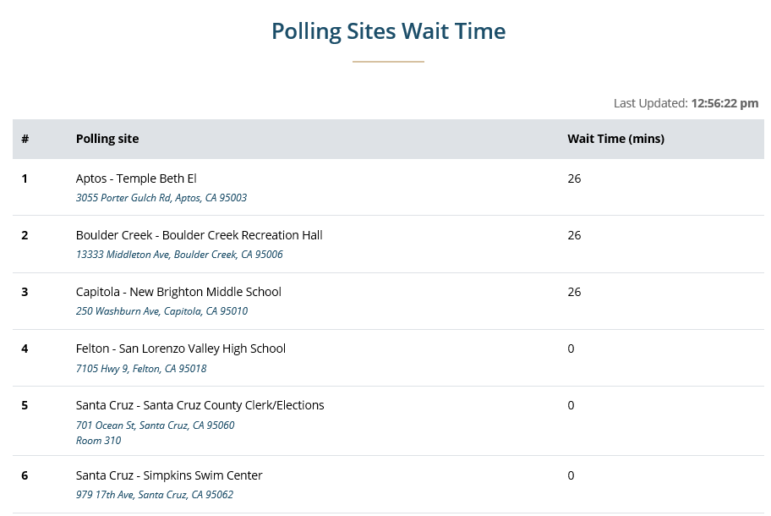

Slide 15
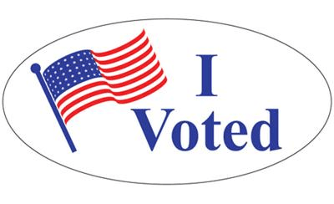
What to expect at in-person voting locations
Traditional Paper Ballot – Vote Here
Upon arrival, you will be greeted and asked if you have any COVID symptoms and an elections official will take your temperature.
If there is room for you inside, you may go to the Check-In Clerk.
You will be asked to give your name and address where you live.
The elections clerk will look you up in the Election Information Management System and get information about your status.
The clerk will ask you if you want to vote here or take a ballot to go.
If you have not yet voted the ballot we mailed you, the elections clerk will void your issued ballot and issue you a replacement ballot.
You will then go to the Ballot Clerk to pick up your ballot.
The clerk will ask if you want to vote on a traditional paper ballot or use the tablet.
As a voter using a traditional paper ballot, you will sign the Voter Information Sheet signing under penalty of perjury that you have not yet voted.
You will be directed to a voting booth to vote your ballot.
Drop your ballot off in the Ballot Drop Box inside the facility before you leave.

Slide 16
What to expect at in-person voting locations
Tablet Ballot – Vote Here
Upon arrival, you will be greeted and asked if you have any COVID symptoms and an elections official will take your temperature.
If there is room for you inside, you may go to the Check-In Clerk.
You will be asked to give your name and address where you live.
The elections clerk will look you up in the Election Information Management System and get information about your status.
The clerk will ask you if you want to vote here or take the ballot to go.
If you have not yet voted the ballot we mailed you, the elections clerk will void your issued ballot and issue you a replacement ballot.
You will then go to the Ballot Clerk to pick up your ballot.
The clerk will ask if you want to vote on a traditional paper ballot or use the tablet.
As a voter using the Tablet, you will sign the Voter Information Sheet signing under penalty of perjury that you have not yet voted.
The Ballot Clerk will give you a Tablet Activation Card.
You may then vote your ballot on the tablet and drop your ballot off in the Ballot Drop Box inside the facility.

Slide 17
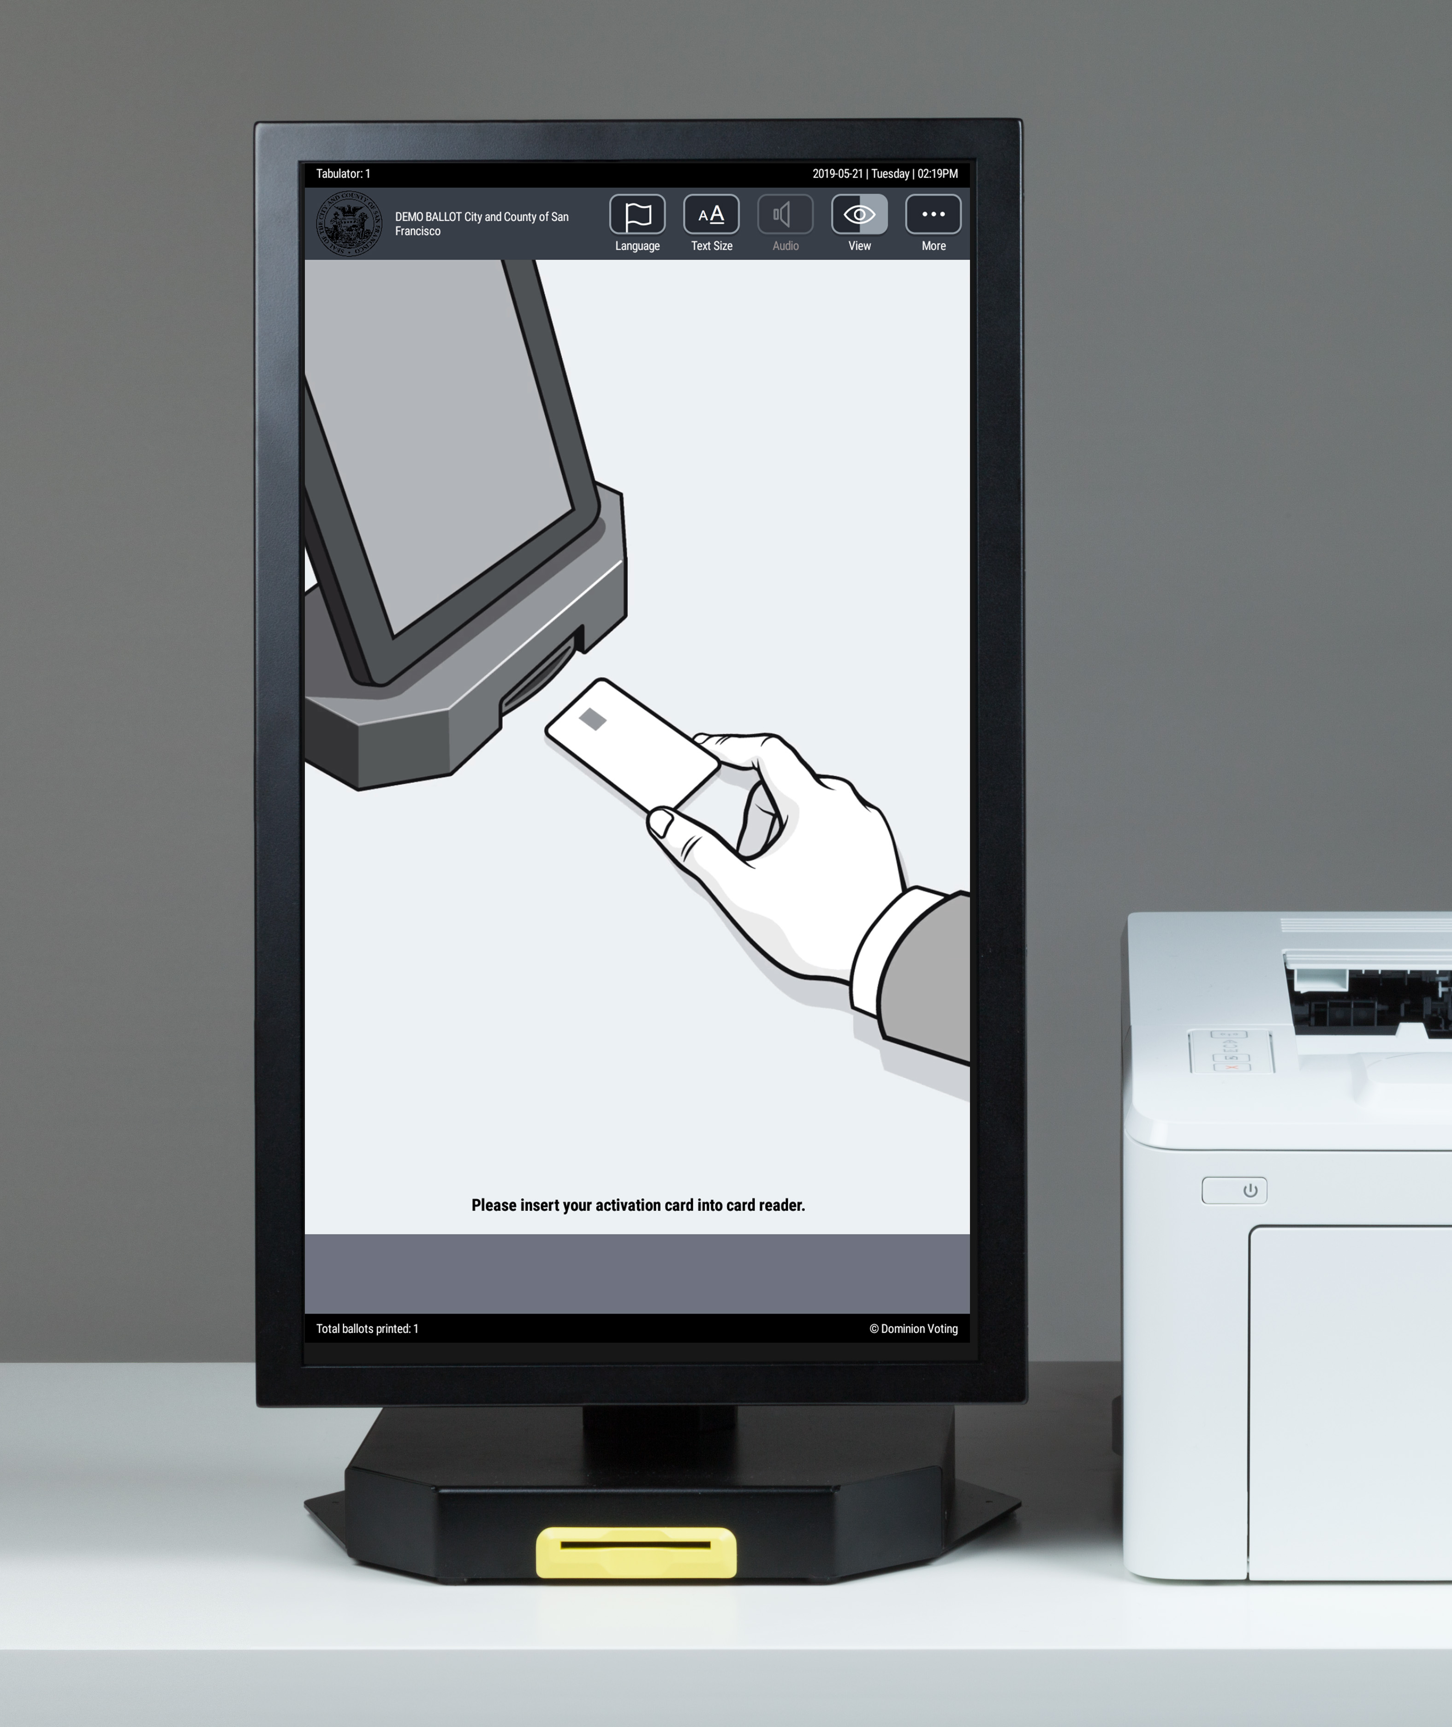
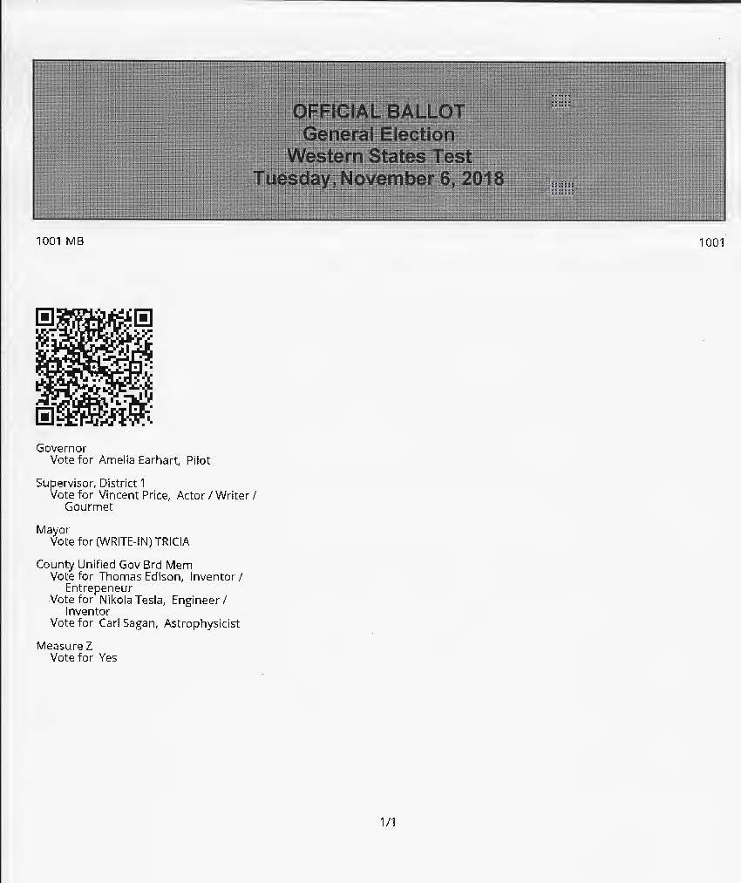
Using the Tablet to vote a Paper Ballot
If you choose the Tablet:
The Tablet Clerk will take your Tablet Activation Card and will use their poll worker card to key up your ballot.
The tablet has accessibility features to allow any voter to vote independently and privately: audio ballot, large font, and a port for someone to use their own assistive device. If you need any of these features, please let the Tablet Clerk know.
The next screen, you select your language: English or Spanish.
Then you make your selections.
When you are done, your ballot will be printed. Your selections are printed on the ballot for you to review.

Slide 18
What to expect at in-person voting locations
Getting a ballot To Go
Upon arrival, you will be greeted and asked if you have any COVID symptoms and an elections official will take your temperature.
If there is room for you inside, you may go to the Check-In Clerk.
You will be asked to give your name and address where you live.
The elections clerk will look you up in the Election Information Management System and get information about your status.
The clerk will ask you if you want to vote here or take the ballot to go.
If you have not yet voted the ballot we mailed you, the elections clerk will void your issued ballot and issue you a replacement ballot.
You will then go to the Ballot Clerk to pick up your ballot.
You will sign the Voter Information Sheet signing under penalty of perjury that you have not yet voted.
The Ballot Clerk will give you a paper ballot for your precinct and a ballot return envelope.
The Ballot Clerk will also give you information on how to return your voted ballot.
And, you can get an “I Voted” sticker if you promise not to wear it until you actually vote!

Slide 19
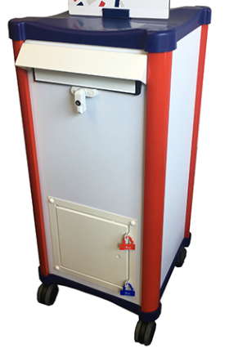
What to expect at in-person voting locations
Dropping off your voted ballot
We will have tents outside and a mobile ballot drop box staffed by two people.
You may be able to drive up and drop off your voted ballot, or you may have to park your car and walk up.
The elections clerk will ask you if it is your ballot and if you signed it.
If so, you may deposit it into the box.
If you are not sure if you signed it, the elections clerk will ask you to pull the tab and sign the ballot envelope before you deposit the ballot.
If you are returning the ballot for someone else, the elections clerk will ask you to print your name, sign your name, and write your relationship to the voter in the space provided on the ballot envelope before depositing it into the ballot box.

Slide 20
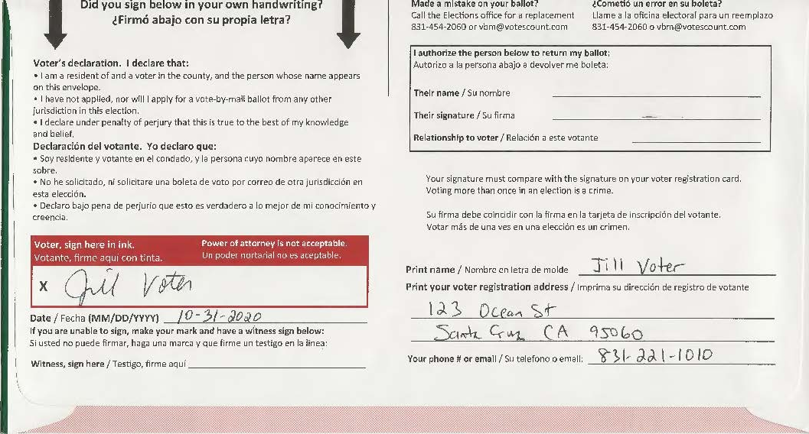
Make sure you sign your ballot envelope in your own handwriting

Slide 21
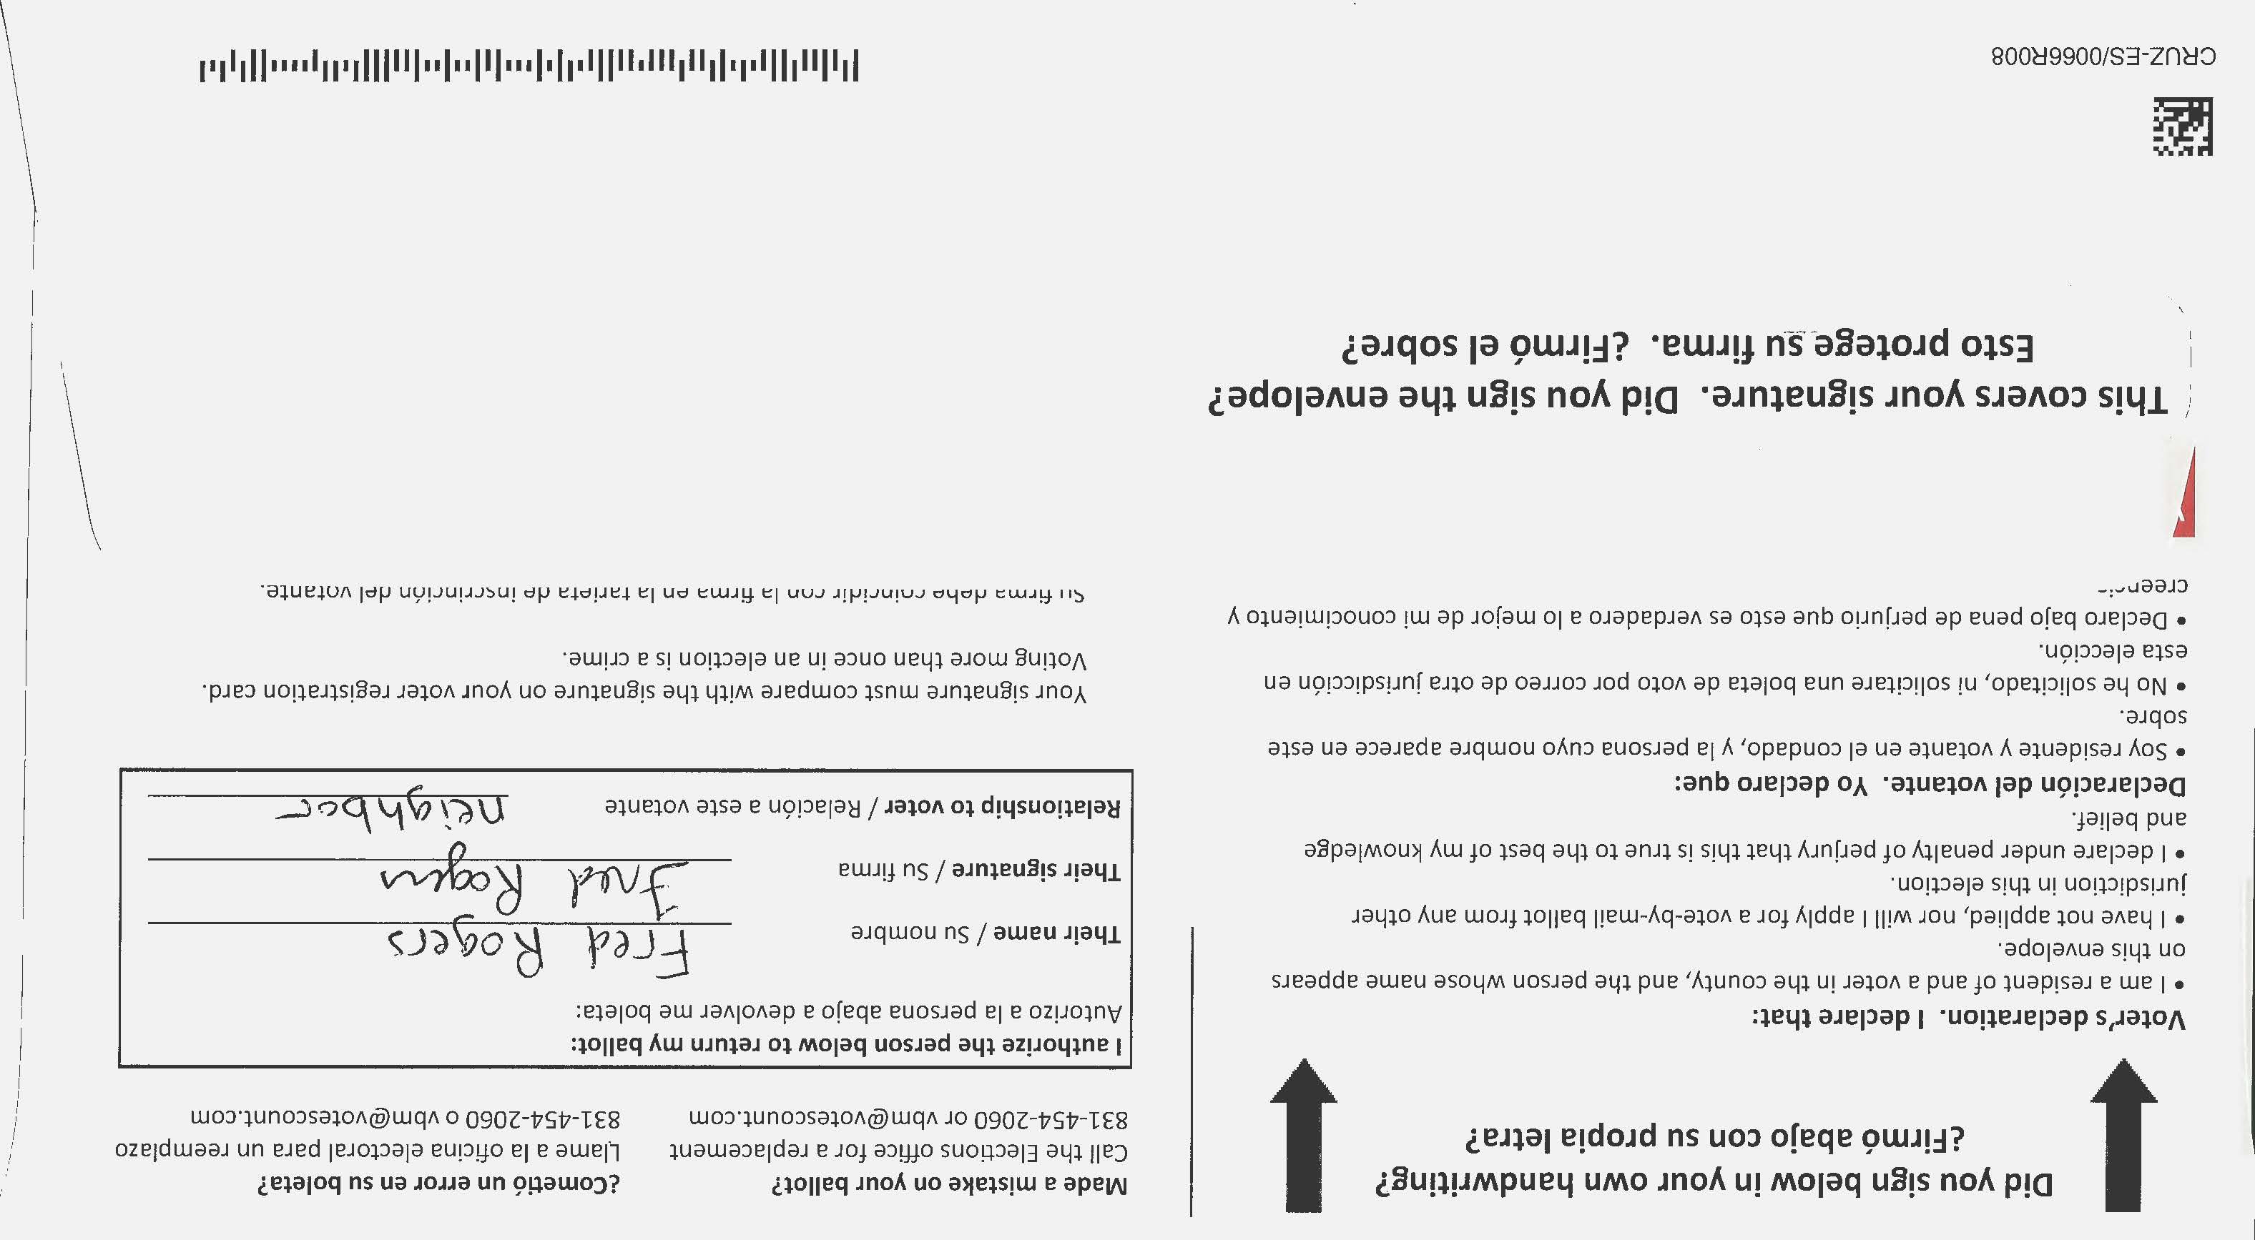
If you need to ask someone you trust to return your ballot
Make sure the person returning your ballot fills out this section on the envelope:
Their name
Their signature
Their relationship to you

Slide 22
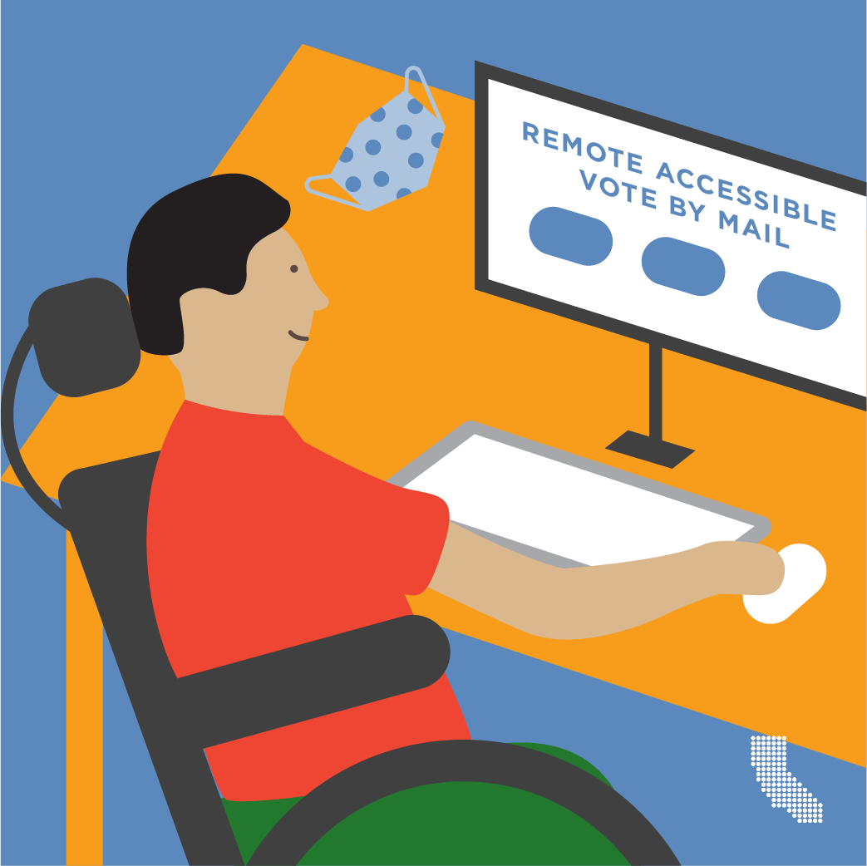
Remote Accessible Vote-by-Mail Ballot - RAVBM
We can email you a ballot if you sign up by October 27: form is online at www.votescount.us or call us at 831-454-2060.
To vote using a RAVBM, you need to have access to a computer, printer and envelopes to return your ballot
We will email you an access code, to access your ballot and vote it.
To return your voted ballot, you will need to use your own envelope unless you have the envelope we sent you. If you use your own envelope, you will need to sign it on the outside and print your name, address, and a way to contact you. You may want to put it in a second envelope to protect your information.

Slide 23

Services for persons with disabilities
Remote Accessible Vote-by-Mail Ballot (RAVBM)
At the voting location
In some voting locations, temporary thresholds, ramps, signage, cones, and door props are used to improve access to the facility.
Curbside voting
If the voting location is not accessible, you may vote on a paper ballot from a nearby accessible location, including a car. A poll worker will qualify you to vote and will return the voted ballot to the voting location.
To request curbside voting assistance, you can:
call in advance to coordinate a time and place
have an assistant make the request inside the voting location
Accessible voting system
Each voting location in the county has a tablet with:
an audio option that reads the ballot to you
a universal plug for personal assistive device
large print (24 points)
a choice of English or Spanish
A ride to your voting location
We can arrange to have an accessible van pick you up and take you to a voting location in Santa Cruz County to vote. Please call 831-454-2060 by Friday, October 30 to make an appointment.
Ballot delivery to your home
We can deliver a ballot to your home and return it to the Elections Department. Please call 831-454-2060 before Election Day so there will be enough time to assist you.

Slide 24
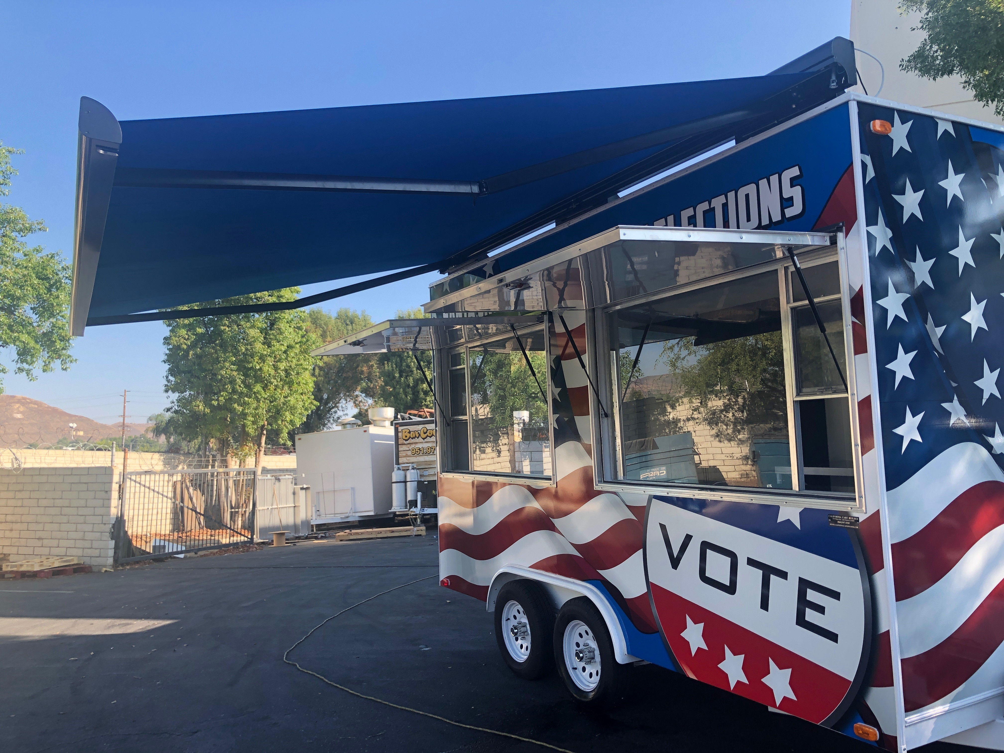
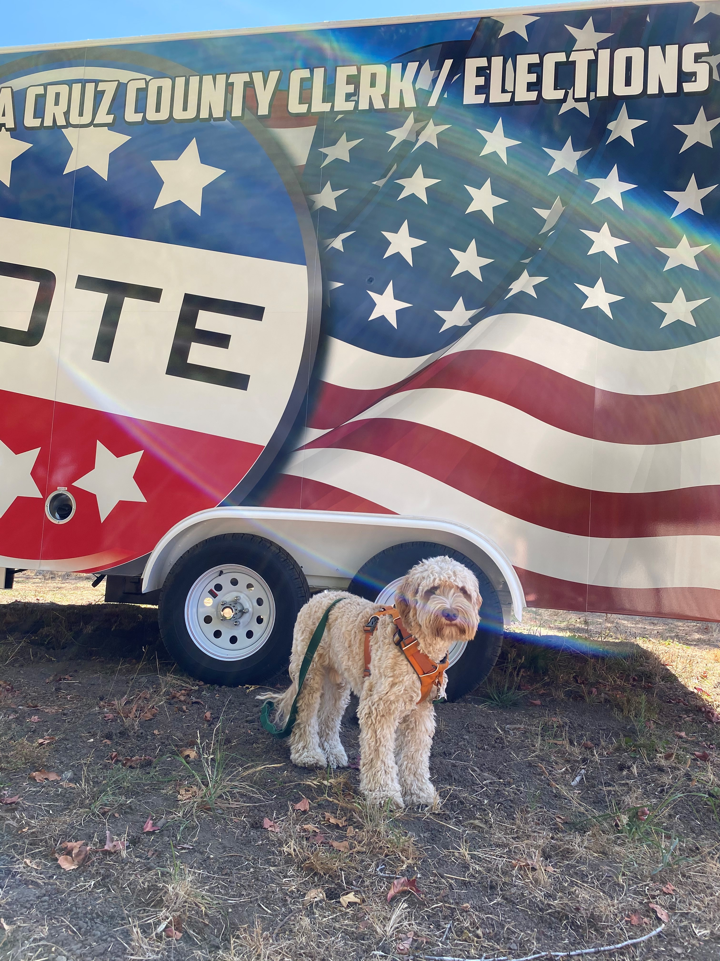
VoteMobile – can go anywhere
We will put together a schedule and post it on our website at www.votescount.us
Davenport
Bonny Doon
Summit
Corralitos
Residential care facilities
Voters can get a replacement ballot, turn in their voted ballot, vote on the tablet or register and vote on the same day.

Slide 25
Current numbers. WOW!!

Slide 26
What’s on the ballot?
Nominees for:
President & Vice President
Congress, 18th and 20th Districts
State Senate, 17th District
State Assembly, 29th and 30th District
Superior Court Judge
County Supervisor, 1st District
Local Offices:
County Board of Ed, TA 3, 5 & 6
Cabrillo Community College Board, TA 5 & 7
San Lorenzo Valley School Dist., TA 3
Pajaro Valley School Dist., TA 3 & 6
Loma Prieta School Dist.
City Councils: Capitola; Santa Cruz, Scotts Valley, Watsonville (Dist. 1, 2 & 6)
San Lorenzo Valley Water Dist.
Soquel Creek Water Dist.
Pajaro Valley Water Management, Div. B
If there was an insufficient number of candidates who filed, they will be appointed in-lieu of election. There were three vacancies where no one filed. Someone will be appointed to fill those spots and serve the full term.

Slide 27
Local Measures
Measure
A
Scotts Valley School District Bond – 55% to pass
Measure
N
Loma Prieta School District Parcel Tax – 2/3 vote to pass
Measure
O
Aromas-San Juan Unified School District Bond – 55% to pass

Slide 28
The Propositions
Proposition 14: Bonds
Would issue $5.5 billion in bonds to stem cell and other medical research.
Dedicates $1.5 billion to fund research and therapy for Alzheimer’s, Parkinson’s, stroke, epilepsy, and other brain and central nervous system diseases and conditions.
Proposition 15: Tax Assessment
Amends Proposition 13 (1978), which limits property tax increases.
Would increase funding for public schools, community colleges, and local governments.
Taxes commercial and industrial properties based on current market value instead of purchase price.
Proposition 16: Affirmative Action
Permits government decision-making policies to consider race, sex, color, ethnicity, or national origin to address diversity by repealing Proposition 209 (1996).

Slide 29
The Propositions – cont.
Proposition 17: Voting Rights
Would restore voting rights of people on parole upon completion of their prison term.
Proposition 18: Voting Age
Seventeen-year-olds would be allowed to vote in primary elections, if they turn 18 before the general election.
Proposition 19: Property Tax
Permits homeowners who are over 55, severely disabled or victims of wildfires and other disasters, to transfer their primary residence’s property tax base to a replacement residence of any value, anywhere in the state.
Proposition 20: Parole
Restricts parole for non-violent offenders and authorizes felony sentences for certain theft crimes currently treated only as misdemeanors.
Makes various changes to the process created by Proposition 57 (2016) for considering the release of inmates from prison.

Slide 30
The Propositions – cont.
Proposition 21: Rent Control
Would allow local governments to establish rent control on housing over 15-years-old, with an exception for landlords who own no more than two homes.
Proposition 22: App-based Employment
Drivers for companies like Lyft, Uber and Doordash would continue to be classified as independent contractors instead of employees.
Criminalizes impersonation of app-based drivers and requires background checks.
Proposition 23: Dialysis Clinics
Requires at least one licensed physician on site during treatment at kidney dialysis clinics; clinics could be exempt from this requirement if there is a shortage of qualified licensed physicians and the clinic has at least one nurse practitioner or physician assistant on site.
Requires state approval for clinic closures or service reductions.
Dialysis clinics would be required to report infection data.
Prohibits clinics from discriminating against clients based on payment source.

Slide 31
The Propositions – cont.
Proposition 24: Consumer Privacy Laws
Would allow consumers to prevent businesses from sharing personal information, to correct inaccurate personal information, and to limit businesses’ use of “sensitive personal information”
Triples maximum penalties for violations concerning consumers under age 16.
Establishes the California Privacy Protection Agency to enforce and implement consumer privacy laws and impose fines.
Proposition 25: Bail System - Referendum
A “Yes” vote approves and a “No” vote rejects a 2018 law that:
  Replaced the state's money bail system with a system based on a determination of public safety and flight risk.
  Limits detention of a person in jail before trial for most misdemeanors.

Slide 32
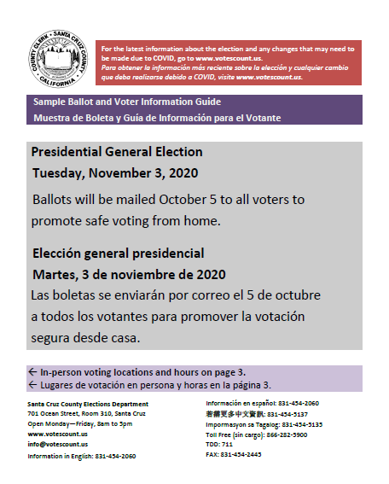
County Voter Information Guide
All guides should be in the mail by tomorrow. Final truck arrives in San Jose tonight.
Guide contains Candidate statements, Local measures, info about voting, drop boxes & voting locations

Slide 33
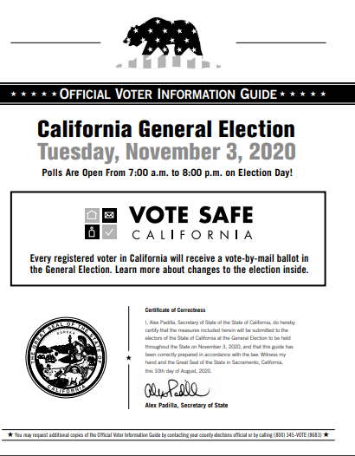
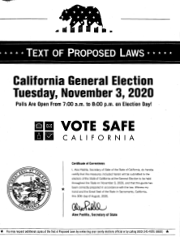
Two State VIGS – only one mailed to voters
Both guides are available online at sos.ca.gov
This guide contains a summary of the 12 State Props + text of Prop 14.
This guide is not mailed to voters. You have to ask for it. Call 831-454-2060. This guide contains the text of Props 15 – 25.

Slide 34
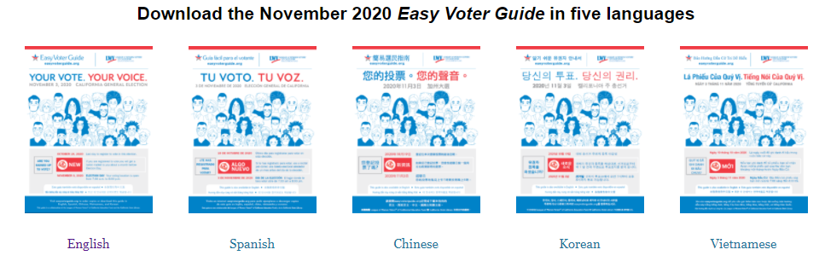
Easy Voter Guide
Produced for statewide elections in California since 1994, the Easy Voter Guide is a collaboration of the League of Women Voters® of California Education Fund and the California State Library. http://www.easyvoterguide.org/

Slide 35

Voter’s Edge
We link to this on our website.
Voter’s Edge California (VEC) is a joint project of MapLight and the League of Women Voters of California Education Fund (LWVCEF).* Voter’s Edge California is a comprehensive, nonpartisan online guide to elections covering federal, state, and local races in the state of California.
https://votersedge.org/ca

Slide 36
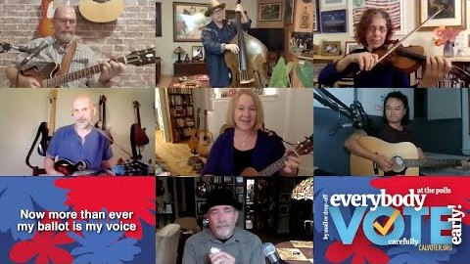
The Voting Way Song by Cal Voter Foundation

Slide 37

Ballot safety & security
Postmark + 17 (new law)
Ballots that are postmarked on or before Election Day or are time stamped or date stamped by a bona fide private mail delivery company on or before Election Day and received by the county elections official by the 17th day after the election – November 20 – shall be considered received on time.
In March 2020, 70,678 vote-by-mail ballots were cast
  852 ballots were challenged
  632 were due to arriving too late, 76.6% of those challenged
The signature on the ballot return envelope is compared to the signature on file by humans.
We know sigs change, and we can tell if someone has aged and it has effected the handwriting.
In March out of 70,678 vote-by-mail ballots cast:
  108 (.0015%) were challenged for no signature (77 were cured)
  95 (.0013%) were challenged because the signature did not compare (35 were cured)

Slide 38

If your signature is challenged
If your signature is missing from your ballot envelope or challenged because it does not compare, we will contact you.
If you sign up for WheresMyBallot.sos.ca.gov you will get an alert.
You have until Nov. 29 to cure your signature by completing a form we will mail to you and post on our website.

Slide 39

Language services
The following election materials will be translated into Spanish and will be available at all our voting locations:
A Spanish version of the ballot on the tablet and one on paper
Voting Instructions
State Voter Information Guide
Voter Bill of Rights
Assistance with voting
As a voter, you may bring up to two individuals with you to your polling place to help you cast your ballot if those individuals do not represent your employer or your union. Your polling place may have poll workers ready to assist voters who speak Spanish and other languages.
Spanish ballot will be mailed to voters who requested Spanish
Since all voters will be mailed a ballot for the November election, we will also mail a copy of the Spanish ballot to the 3,490 voters who have asked for election materials in Spanish. It will be in a separate mailing from their official ballot.

Slide 40

No electioneering
No one can solicit the vote of a vote-by-mail voter, or do any electioneering, while in the residence or in the immediate presence of the voter, and during the time he or she knows the vote-by-mail voter is voting.
Electioneering is also prohibited within 100 feet of a voting location.
Any person who knowingly violates this section is guilty of a misdemeanor.

Slide 41
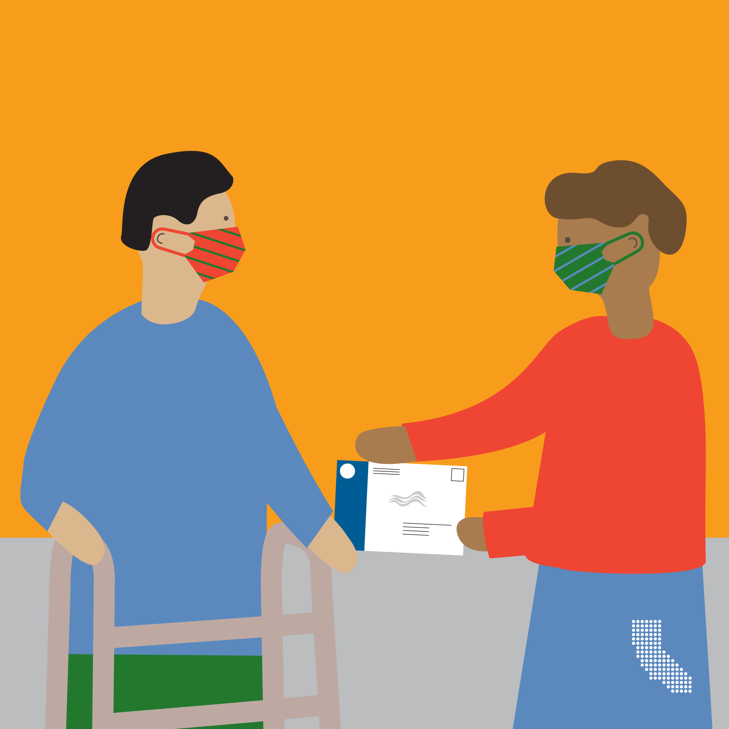
Don’t let a stranger return your ballot
If a voter cannot return their ballot without assistance, they are encouraged to enlist the help of someone they know and trust.
The person who returns the ballot must print their name, sign their name and write their relationship to the voter on the envelope in the space provided.
If voters do not have anyone available, they can call our office at 831-454-2060 and we will send an elections official to pick up the ballot.

Slide 42
If you see something, SAY SOMETHING!
If you suspect voter fraud, please contact the Secretary of State. They have a complaint form posted online at https://www.sos.ca.gov/elections/publications-and-resources/voter-complaint/
You may also call the Secretary of State at:
English: (916) 657-2166 or (800) 345-VOTE (8683).
Spanish: (800) 232-VOTA (8682)
You may also contact the Santa Cruz County Clerk at 831-454-2060 or info@votescount.us. The County Clerk is not authorized to do investigations, so the office will refer the case to the appropriate local agency.

Slide 43
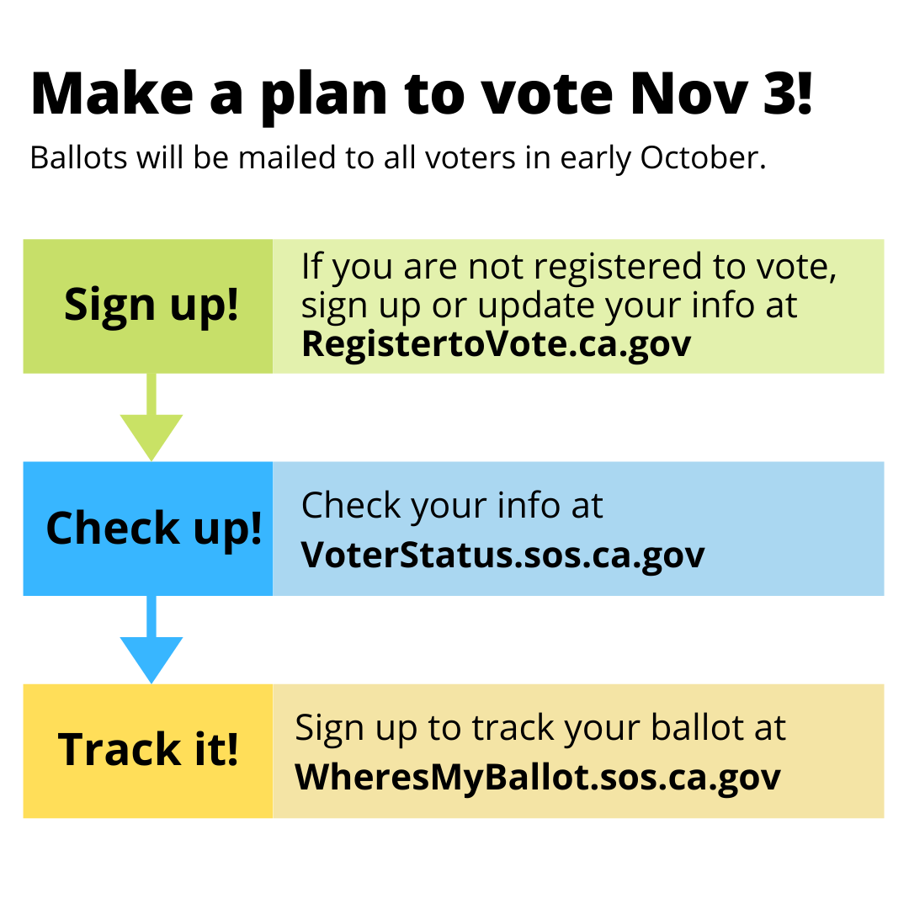
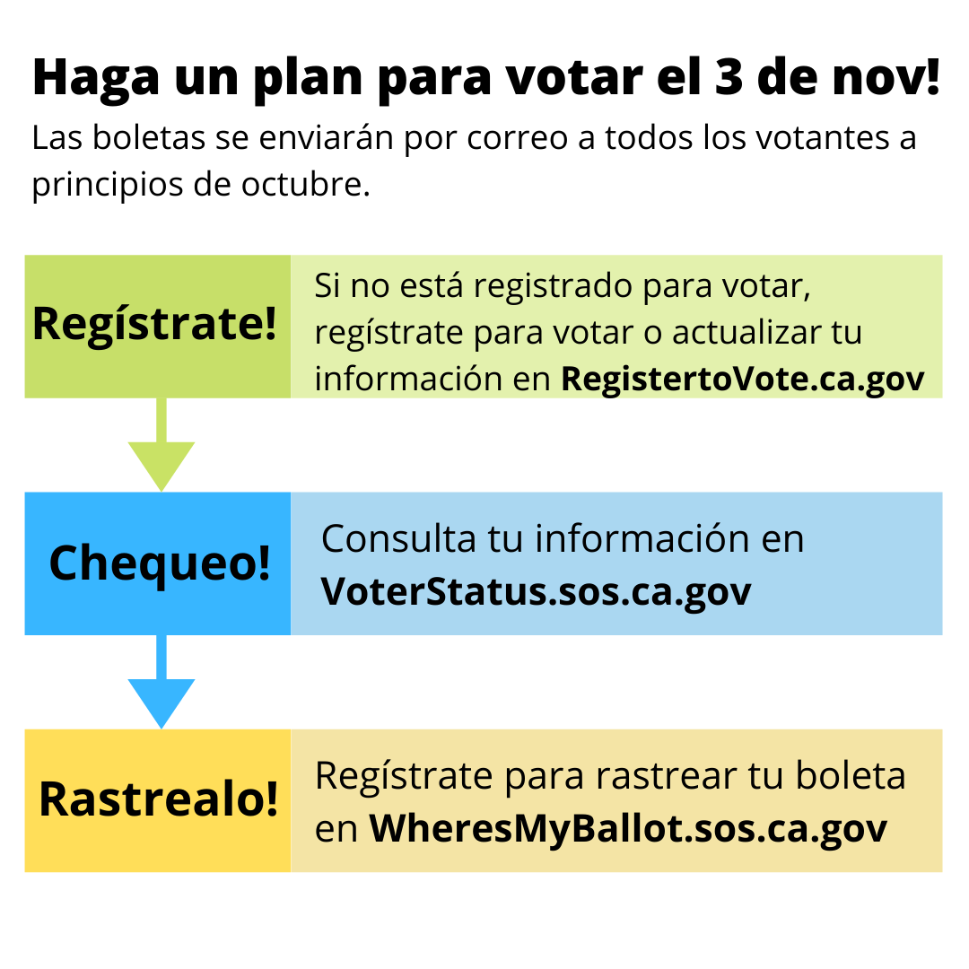
Make a plan to vote!

Slide 44
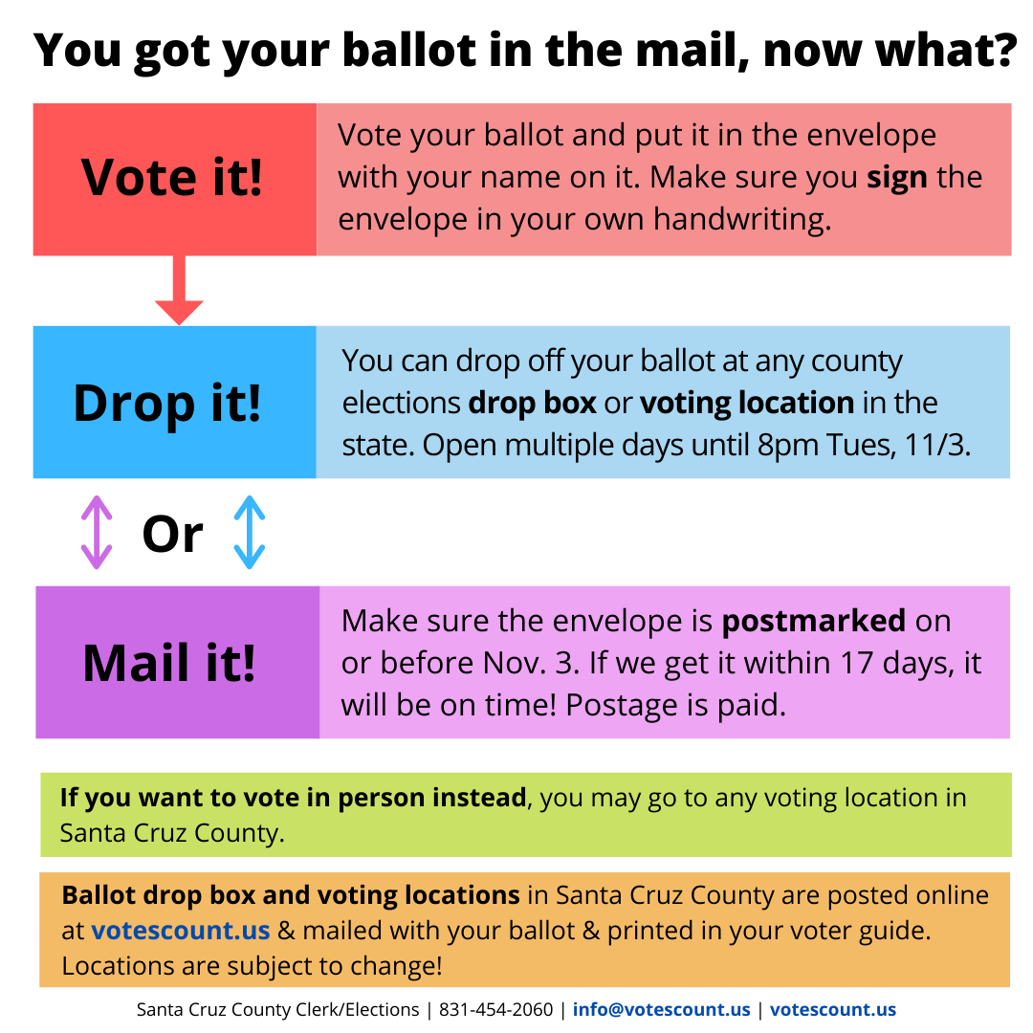

Slide 45
Help us spread the word! Be a trusted messenger!
Ballots will be mailed to all active registered voters on October 2.
Register to vote online at registertovote.ca.gov
If you don’t have a CA driver’s license or ID, you will need to print, sign and return your voter registration. Or pick up a voter registration card at any post office, library, city hall, county elections, or we can mail voters a card.
Deadline to register is October 19. Same Day Registration is available for those who miss the deadline.
Check to make sure your voter information is correct at voterstatus.sos.ca.gov
Sign up to track your ballot at wheresmyballot.sos.ca.gov

Slide 46
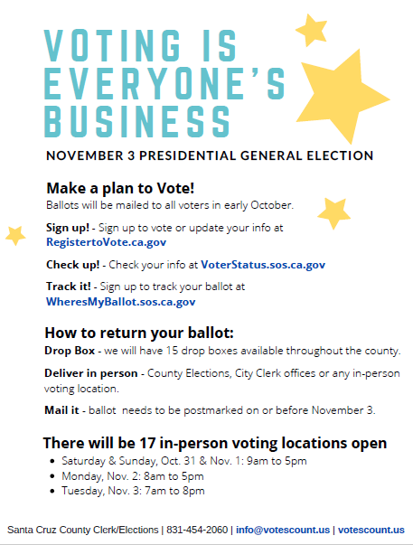
If you own a business, we need you!
Post our sign “Voting is everyone’s business”
Have voter registration cards and promote the last day to register to vote.
Contact Helen Ruiz-Thomas at 831-454-3389 or helen.ruiz-thomas@santacruzcounty.us

Slide 47
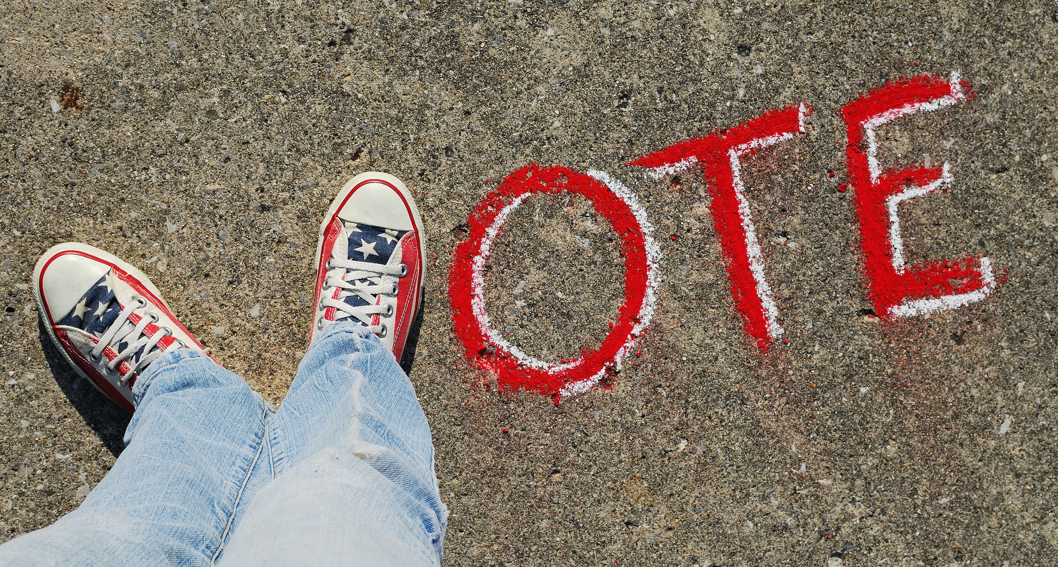
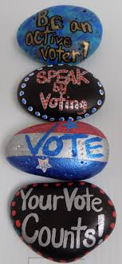
How you can spread the word
Talk to your family, friends, neighbors
Chalk art
Rock art
Car art
Social media
Newsletters (churches, schools, groups, organizations)
Email
Yard signs to promote voting!

Slide 48
Observers are always welcome
We are getting a few cameras so you can watch our ballot processing and counting from the safety and comfort of your own home.
Information about observing our processes is posted online at www.votescount.us
Anyone can observe any procedure at the voting locations (except as to how someone voted). Persons are permitted to observe voting but MUST NOT INTERFERE with the duties of the Elections Officers. They may not handle official ballots or intrude upon the voting process.
If you would like to be an election observer, please notify:
  Gail Pellerin at gail.pellerin@santacruzcounty.us, 831-454-2419, or
  Tricia Webber at tricia.webber@santacruzcounty.us, 831-454-2409

Slide 49

Delivering democracy takes many people
Voting locations – people who have signed up to work all 4 days will be assigned in early October.
More people will be assigned to work Tuesday only.
A team will be assigned to manage the VoteMobile.
Online training will be required of ALL election workers, plus there will be some in-person labs.
Two-person teams are being assigned to manage the ballot drop boxes. We need 15 two person teams to empty boxes daily and empty and lock at 8pm on Election Night, Nov. 3.
Election Worker hotline – staffed by county employees and some volunteers.
Voter Hotline – plans are to staff with county employees – must work from county workstation.

Slide 50

Key dates and milestones
Oct. 1, 2020 - 33 Days until Election Day!
Sept. 15, 2020 to Oct. 15, 2020 - Hispanic Heritage Month.
This week - County Voter Information Guides will be mailed to voters.
This week - State Voter Information Guides will be mailed to all households.
Oct. 2, 2020 – Ballots will be mailed to all voters in Santa Cruz County.
Oct. 5, 2020 - County Elections and Watsonville City Clerk open for voting.
Oct. 6, 2020 - Drop Boxes are available.
Oct. 12, 2020 - Indigenous Peoples’ Day.
Oct. 19, 2020 - Close of Registration for administrative purposes. Voters may still register and vote right up through Election Day.
Oct. 27, 2020 – Last day to request a RAVBM.
Oct. 31, 2020 - Happy Halloween – 16 additional in-person voting locations open.
Nov. 3, 2020 - Election Day is the last day to vote!
Nov. 29, 2020 – Last day to cure a signature.
Dec. 1, 2020 – Deadline to certify the election.

Slide 51
Assuming Office Dates
December 4 – Special Districts: Candidates declared elected or appointed take office this date at noon after having taken the oath or posted any bond required by the principal act. §10554
December 4 – School and Community College Districts: Candidates elected to school board take office, though no reference is made to “noon.”
December 7 – State Senate and State Assembly Members take office.
December 8 – Santa Cruz & Watsonville City council members take office.
December 10 – Capitola City council members take office.
December 16 – Scotts Valley City council members take office.
January 3 – Congressional members take office.
January 4 – County Supervisors and Superior Court Judges take office.
January 20 – Inauguration Day. President takes office at noon.

Slide 52
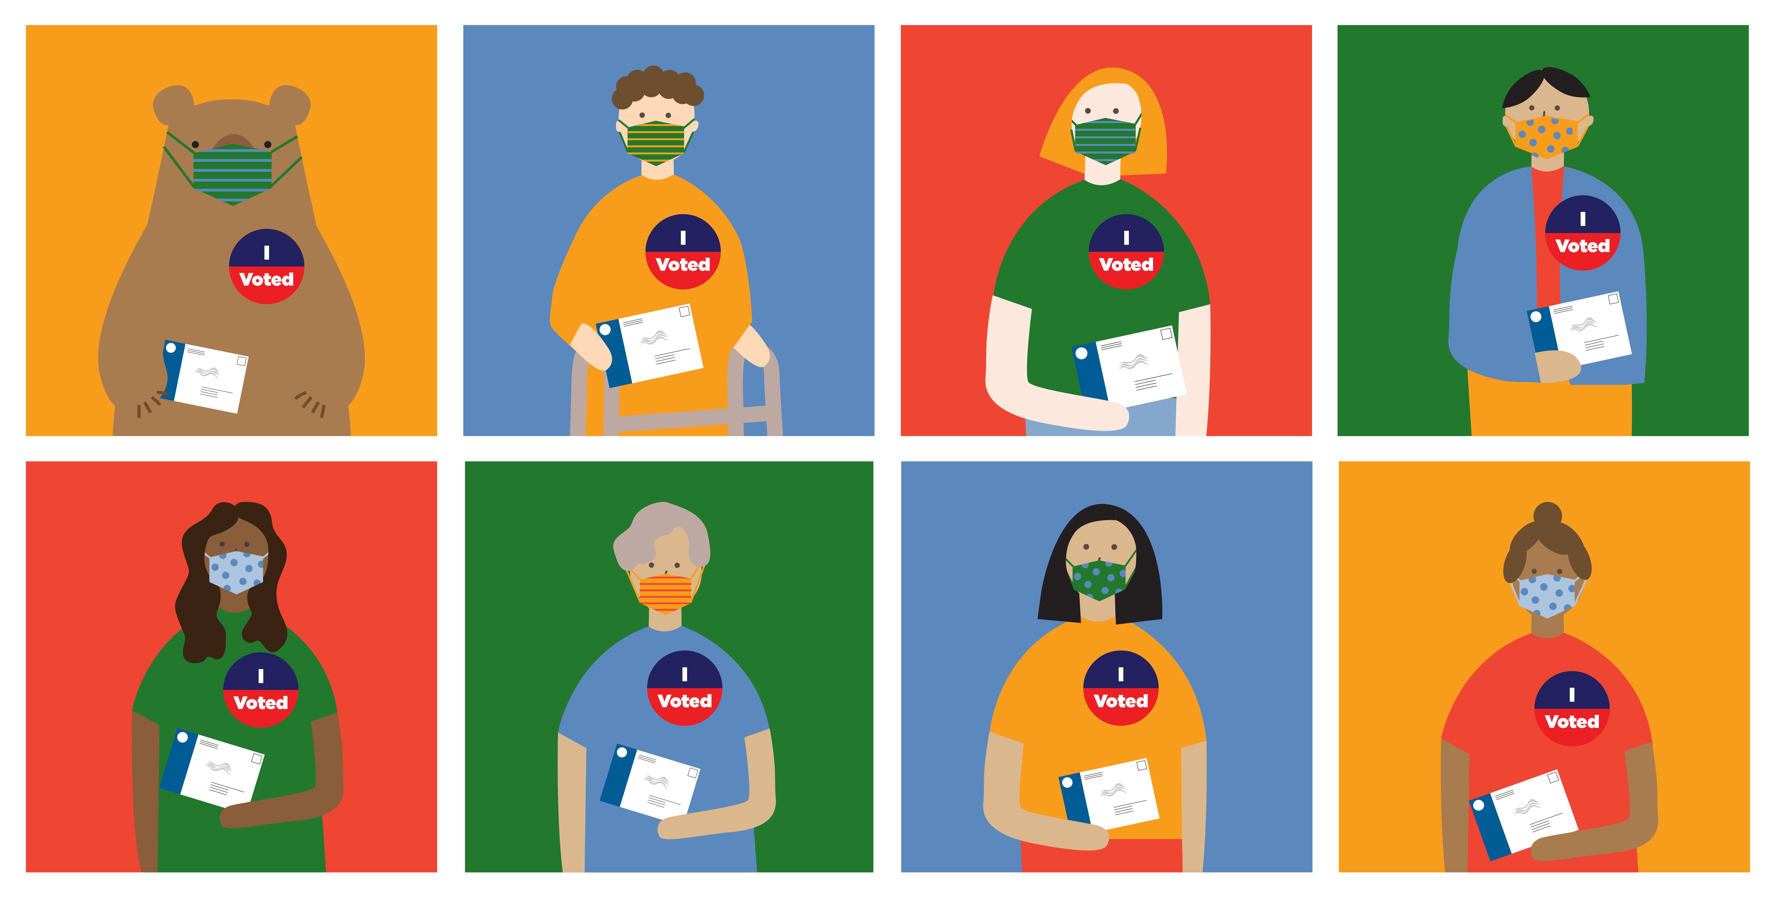
Thank you for participating!
Gail L. Pellerin
County Clerk
831-454-2060 (main)
831-454-2419 (direct)
info@votescount.us
www.votescount.us
Special thanks to
Future of California Elections for many of the graphics!

